Slide 1

PRADA
“The end – the absolute”

Slide 2
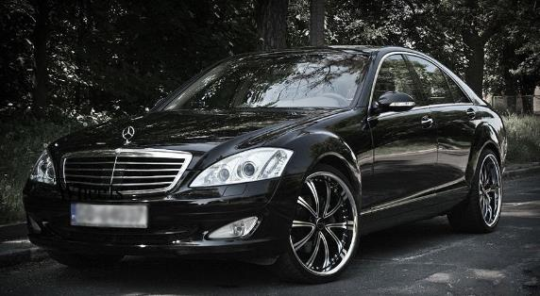
The Mercedes S550
The car I hope to own in the near future.

Slide 3
The Price Tag
Although it appears expensive at first glance
…with MSRP starting at $94,400…

Slide 4
It’s actually quite affordable
Thanks to depreciation & economics
Higher Priced
Depreciates Quicker

Slide 5

Why?
High-end luxury cars = smaller demographic
interested in leasing new
Therefore, when it ages…It causes
  a lower demand for the car
  higher saturation

Slide 6
Depreciation Schedule
Mercedes S550
Year | Depreciation | Price After Depreciation (MSRP $94,400)
2015 | $33,590 | $60,810
2014 | $7,625 | $53,185
2013 | $6,550 | $46,635
2012 | $6,925 | $39,710
2011 | $7,075 | $32,635
Source: http://www.cars.com/mercedes-benz/s-class/2014/costofownership
Notes:
Side note: the one I want is actually a 2007. Although it is old, it is still the top of the line and is comparable to its competitions new 2015 car. The difference is, it’s at a $20,000 price point versus $80,000 or more.

Slide 7
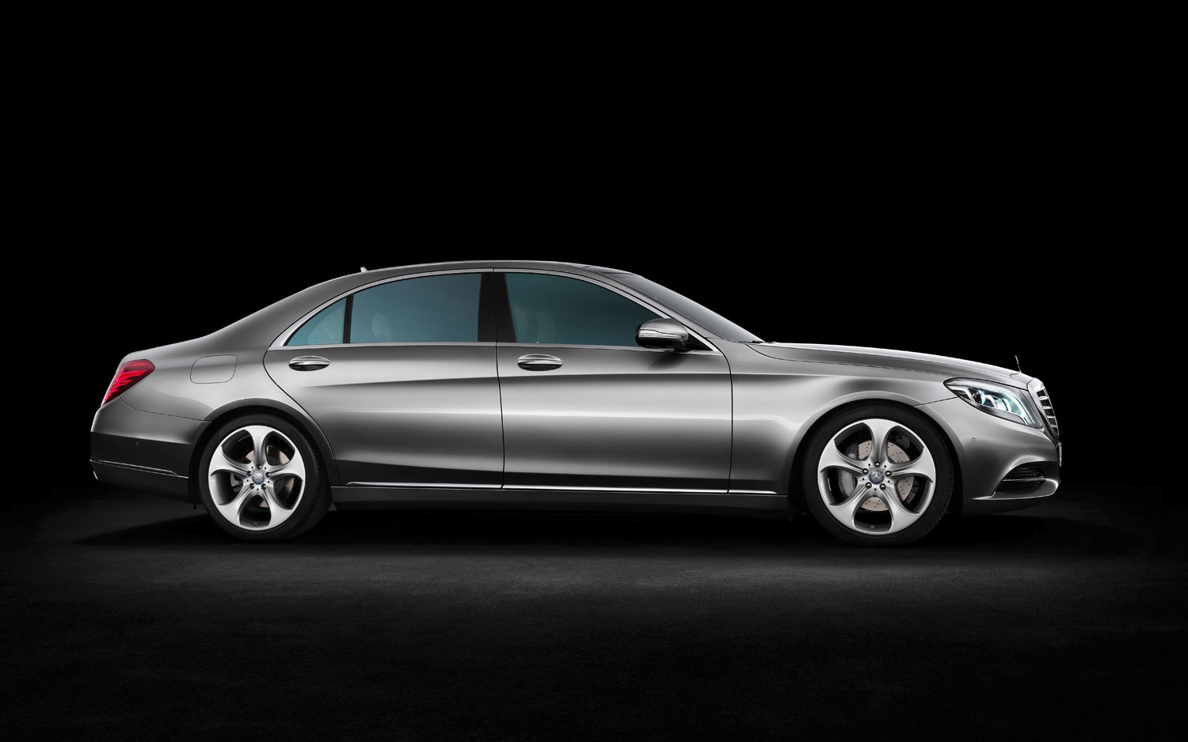
Engineering at it’s finest…

